Slide 1
Predictive Model Building with Logistic Regression
Response Variable : Above_Median (price higher than median price)
Predictors
Overall_Qual, Gr_Liv_Area, Garage_Cars, Garage_Area, Total_Bsmt_SF, First_Flr_SF, Full_Bath, Year_Built, Year_Remod_Add, Neighborhood
Split: Train 80% and Test 20% of the dataset
No cross validation fold applied
Results
Train Accuracy: 0.9071 Sensitivity: 0.9143 Specificity: 0.9049
Test Accuracy: 0.9066 Sensitivity: 0.9080 Specificity: 0.9051
Naïve 0.5078

Slide 2
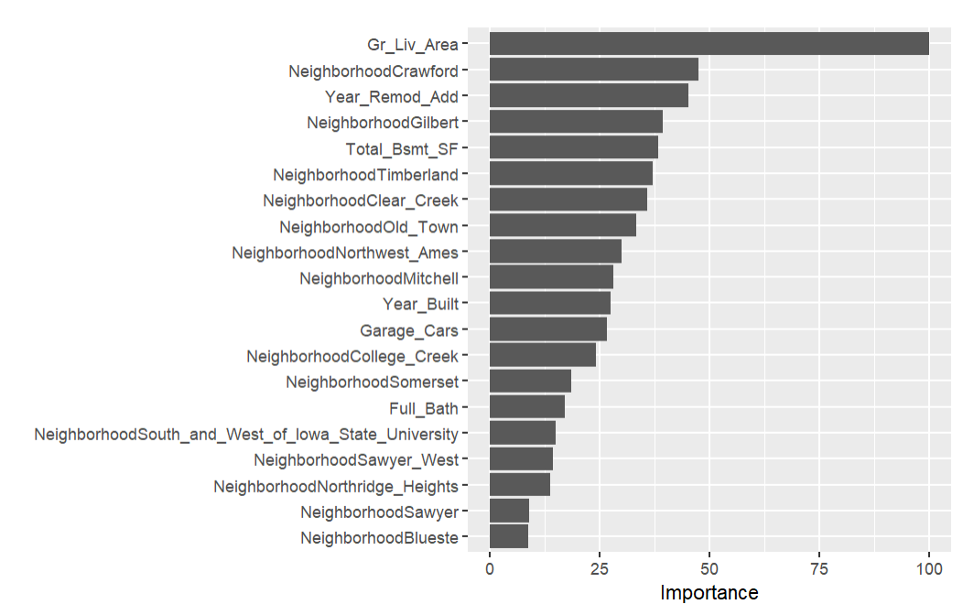
Most Important Variables
Vip chart indicates that the most important variable is Gr_Liv_Area. Other important variables are neighborhood and year of remodeling.

Slide 3
Predictive Model Building with Decision Tree
Response Variable : Above_Median (price higher than median price)
Predictors
Overall_Qual, Gr_Liv_Area, Garage_Cars, Garage_Area, Total_Bsmt_SF, First_Flr_SF, Full_Bath, Year_Built, Year_Remod_Add, Neighborhood
Split: Train 80% and Test 20% of the dataset
No cross validation fold applied
Results
Train Accuracy: 0.8980 Sensitivity: 0.8721 Specificity: 0.9247
Test Accuracy: 0.8988 Sensitivity: 0.8889 Specificity: 0.9091
Naïve 0.5078

Slide 4
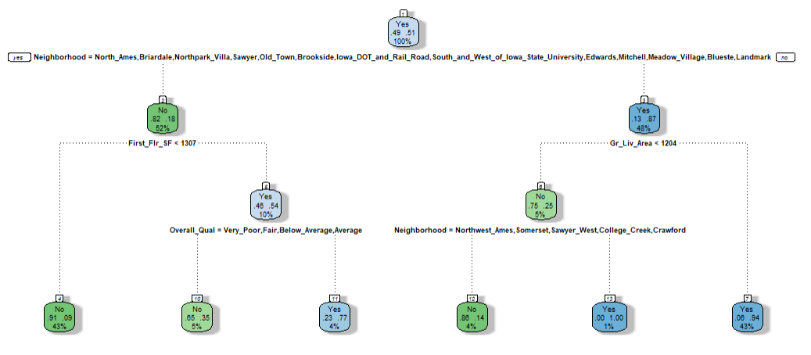
Decision Tree Graph

Slide 5
Predictive Model Building with Random Forest
Response Variable : Above_Median (price higher than median price)
Predictors
Overall_Qual, Gr_Liv_Area, Garage_Cars, Garage_Area, Total_Bsmt_SF, First_Flr_SF, Full_Bath, Year_Built, Year_Remod_Add, Neighborhood
Split: Train 80% and Test 20% of the dataset
No cross validation fold applied
Results
Train Accuracy: 0.9682 Sensitivity: 0.9680 Specificity: 0.9683
Test Accuracy: 0.9086 Sensitivity: 0.8851 Specificity: 0.9328
Naïve 0.5078

Slide 6
Predictive Model Building with Extreme Gradient Boosting (Xgboost)
Response Variable : Above_Median (price higher than median price)
Predictors
Overall_Qual, Gr_Liv_Area, Garage_Cars, Garage_Area, Total_Bsmt_SF, First_Flr_SF, Full_Bath, Year_Built, Year_Remod_Add, Neighborhood
Split: Train 80% and Test 20% of the dataset
5 K fold cross validation applied
Results
Train Accuracy: 0.9766 Sensitivity: 0.9770 Specificity: 0.9762
Test Accuracy: 0.9047 Sensitivity: 0.8927 Specificity: 0.9170
Naïve 0.5078

Slide 7
Recommendation
Based on performance comparison of Logit, Decision Tree, Random Tree, and XGBoost methods, Logit seems to offer more stable and a model without overly overfitting. Other models’ performance matrix indicates that there are some evidence of performance degradation between train and test dataset, indicating some overfitting.
Additional advantage of Logit modeling is it offers better interpretability compared to other models. However, with better tuning for XGBoost and random tree modeling, the performance results may improve further, resulting in outperforming Logit model. Overall performance can also be improved by introducing resampling technique across different models.

